Slide 1
Prediction of Carbon Monoxide levels
Using the concentration of other gases

Slide 2
Outline
Given Problem and Dataset
Variable Description
Exploratory Data Analysis
Data Pre-Processing
Model Development
Model Validation

Slide 3
Given Problem and Dataset
Carbon Monoxide is increasing day by day and have adverse impacts on our health.
Hence, the government decided to monitor CO levels of a factory or region by analysing its several features thereby taking counter measures to reduce CO levels in a region.
Our task is to create a predictive model that can predict CO level based on other parameters.

Slide 4
Variable Description
The Data given here is from March 2004 to February 2005 (one year):
Date (DD/MM/YYYY)
Time (HH.MM.SS)
True hourly averaged concentration CO in mg/m^3 (reference analyzer)
PT08.S1 (tin oxide) :hourly averaged sensor response (nominally CO targeted)
NHMC: True hourly averaged overall Non Metanic HydroCarbons concentration in microg/m^3 (reference analyzer)
C6H6: True hourly averaged Benzene concentration in microg/m^3 (reference analyzer)
PT08.S2 (titanium dioxide) hourly averaged sensor response (nominally NMHC targeted)
NOx: True hourly averaged NOx concentration in ppb (reference analyzer)
PT08.S3 (tungsten oxide) hourly averaged sensor response (nominally NOx targeted)
NO2: True hourly averaged NO2 concentration in microg/m^3 (reference analyzer)
PT08.S4 (tungsten oxide) hourly averaged sensor response (nominally NO2 targeted)
PT08.S5 (indium oxide) hourly averaged sensor response (nominally O3 targeted)
T: Temperature in Â°C
R: Relative Humidity (%)
AH :Absolute Humidity

Slide 5
EXPLORATORY DATA ANALYSIS

Slide 6
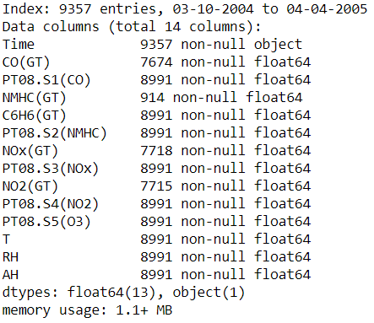
Exploratory Data Analysis
The information about the various columns were found such as the number of rows which have non-null values and their data type.

Slide 7
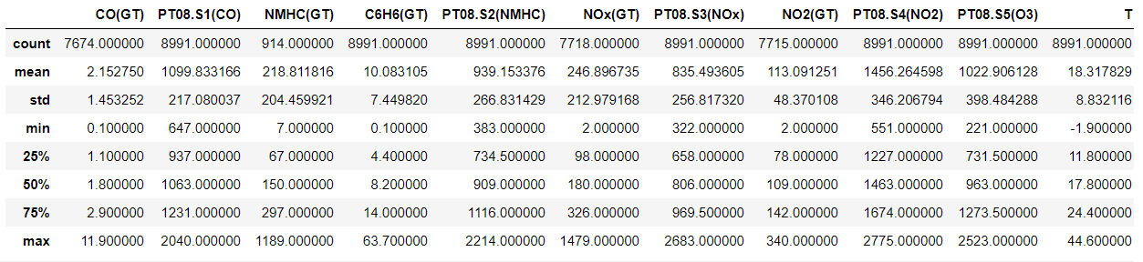
The no. of rows and columns were calculated. The data contains 9357 rows and 12 columns.
The basic statistical information like row count, mean , standard deviation, quartile values, minimum and maximum value of each row is displayed.

Slide 8
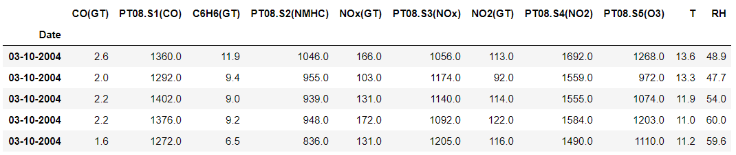
The columns which did not have any have any influence over the data were dropped.

Slide 9
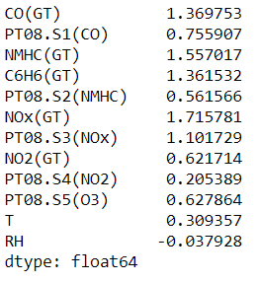
The asymmetry of the probability distribution of a real-valued random variable about its mean was calculated in order to replace the null values with mean.

Slide 10

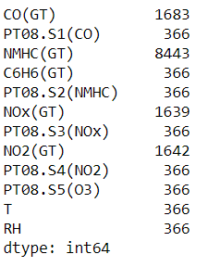
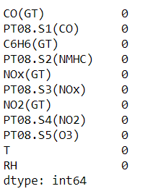
Replaced the null values in the column with the mean of other values.

Slide 11
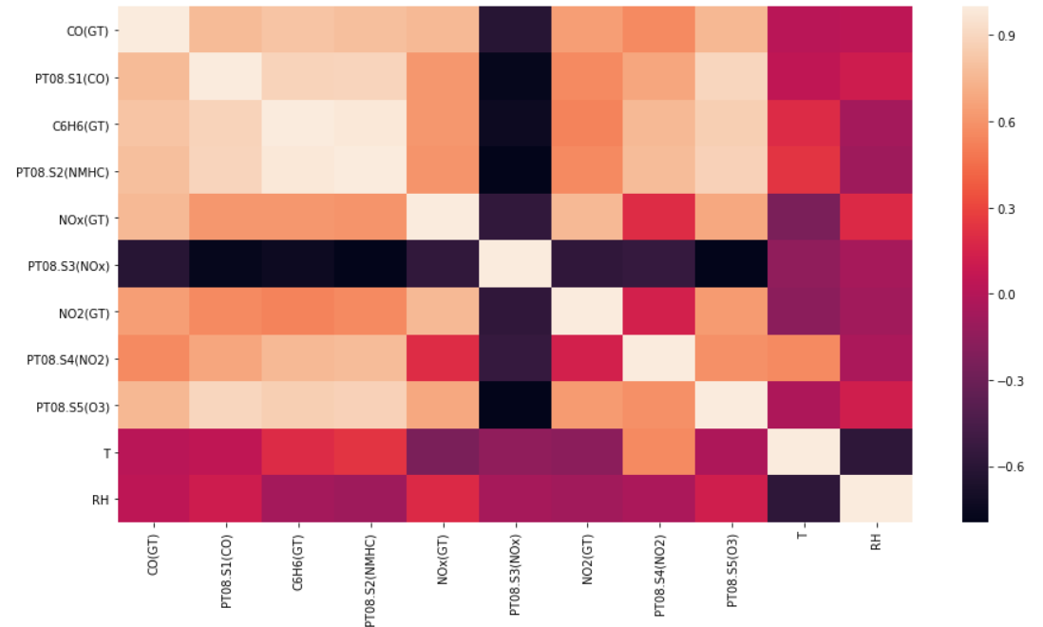
Correlation Heatmap

Slide 12
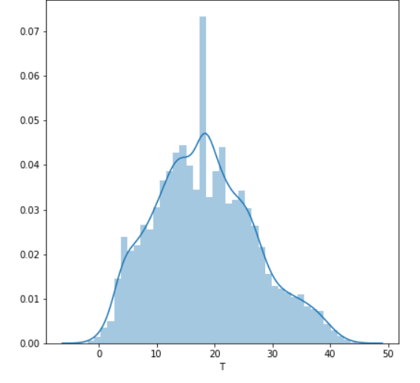
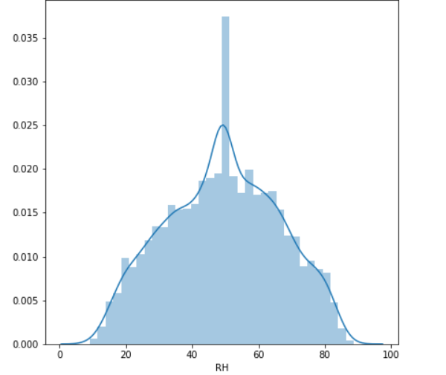
Frequency Distribution of Temperature and Relative Humidity

Slide 13
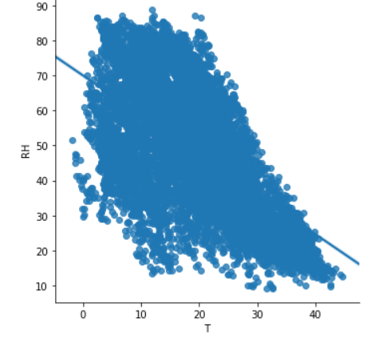
Graph Plot Temperature vs Relative Humidity

Slide 14
Few observations from EDA
The columns which were found to have null values were replaced by the mean values of the data.
The column NMHC(Non Metanic HydroCarbons concentration) had 8443 null values, which was dropped in comparison to the 9357 data values.
The skewness that is, the asymmetry of the probability distribution of a real-valued random variable about its mean was calculated and accordingly the null values were replaced by their mean.

Slide 15
Data Pre-processing
Dataset considered for this project was cleaned by removing unnecessary columns.
We have partitioned our dataset into training and testing set using simple random sampling.
We dropped the following 2 columns as they were not adding any meaning for modeling purpose:
Absolute Humidity
Time

Slide 16
Model Development
First, plotting the histogram to analyse the frequency distribution of the various numerical values.
Found the Correlation value that describes the strength of the linear association between two quantitative variables that is, how well the variables are related.

Slide 17
Model :Regression
This algorithm is widely used in Data Science and Machine learning.
Multiple Regression
For our prediction we had to use only the certain variable which were having a high correlation with the concentration with the Carbon Monoxide.

Slide 18
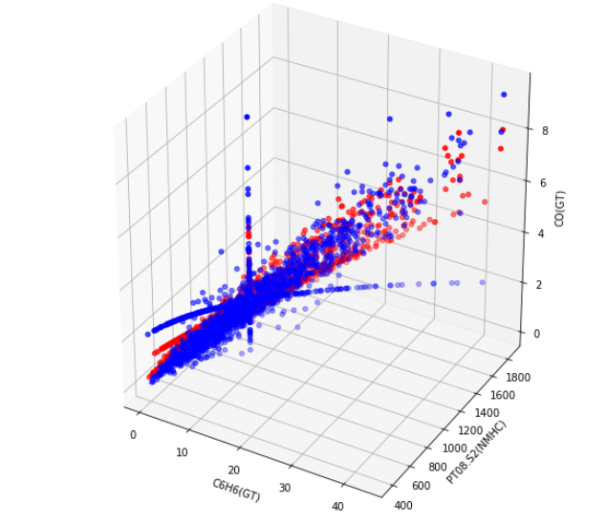
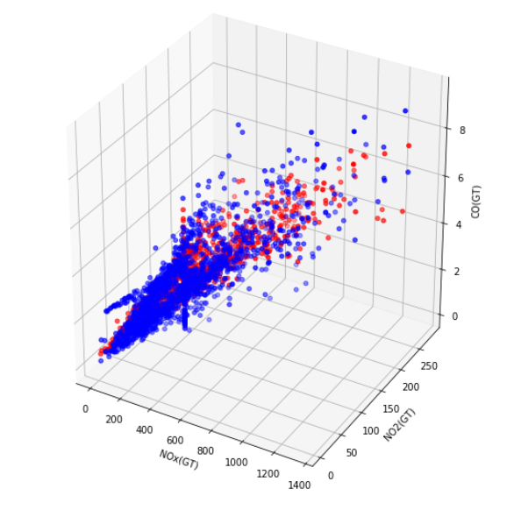
Graph of predicted variables form

Slide 19
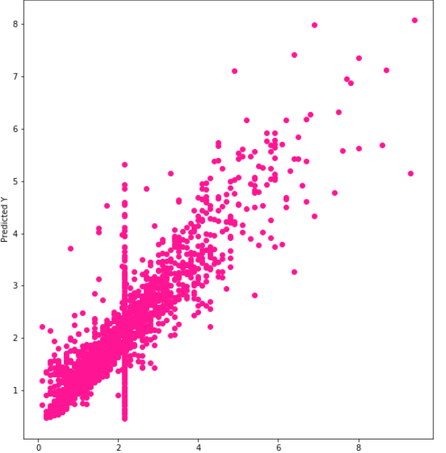
Prediction Graph

Slide 20
Assumption
From our analysis we made a few deductions as to what are the main compounds which affect the concentration of Carbon Monoxide in the environment.
Compound which were factors to increase in Carbon Monoxide:
Benzene(C6H6)
Non Metallic Hydrocarbons(NMHC) such as Titania (Titanium (IV)Oxide)
NO2

